Slide 1
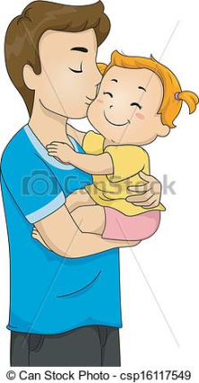
Tots on Tuesdays!
NEW
Germoe Community Pre-School, Nursery and Primary School
1.30 – 3pm From New born to Pre-School Age group.
Term time only in the Nursery
Are you a parent or carer of a baby or toddler?
We welcome you to Tots on Tuesdays, a great place to meet other parents and a fantastic opportunity for your toddler to socialise in our safe and friendly nursery environment, run by an experienced Early years teacher.
Crafts
New friends
Chat
Baby and Toddler play
Music
Stories
block play
Activities vary from week to week
So bring your little ones along and join in the fun!
Stay and play for £1.00 per session
Refreshments and snacks included.
Information contact Germoe School
01736 763310 Website www.germoe.cornwall.sch.uk

