Slide 1
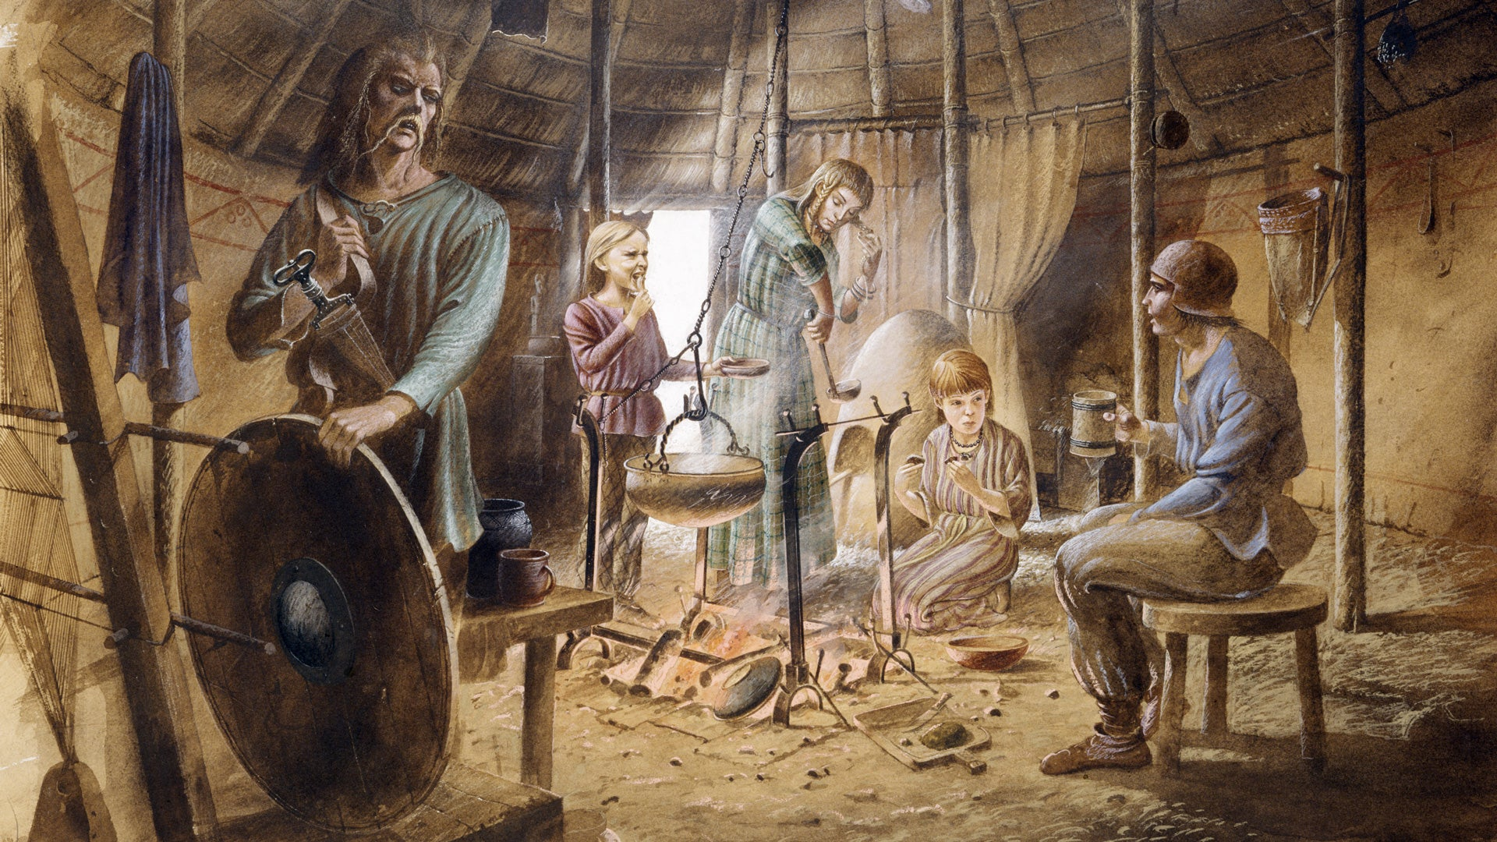
Computing
We will be learning to how to use seesaw, research online and create PowerPoints to showcase our learning.
French
We will be practicing speaking and listening in French, by learning classroom instructions and the French alphabet.
Maths
We will be focusing on multiplicative reasoning, geometric reasoning and number sense.
PSHE/RSE
Our big question for PSHE this half term is ‘Do we have to be influenced by others or can we influence ourselves?’, focusing on celebrating differences.
PE
Hockey and Rugby
We will focus on Hockey and Rugby this half term, by following the rules of the game and playing fairly, maintaining possession of a ball with our hands, passing to teammates at appropriate times, and leading others and act as a respectful team member.
Stone Age to Iron Age
How did daily life in Britain change from the Stone Age to the Iron Age?
English
Non-chronological report
We will be writing non-chronological reports this half term, learning the text-specific language features and writing our own reports.
Recount – Science experiment
We will be writing a recount on which liquids cause the most damage to our teeth.
Explanation text
We will be writing an explanation text on how the digestive system works.
RE
We will be learning about Christianity this half term, striving to answer the question, ‘What is trinity?’ and learning about Christmas.
Music
We will be learning to perform and describe Music.
Science
We will be learning to understand animals and humans this half term. We will focus on systems of the human body, answering ‘How do the systems inside our body work to make a healthy human?’
Inquiry
Our inquiry will be focused on the Stone Age and Iron Age by discussing what we know and what we want to find out, looking into the history of the transition from the Stone Age to the Iron Age, and painting our own Paleolithic cave paintings.

