Slide 1
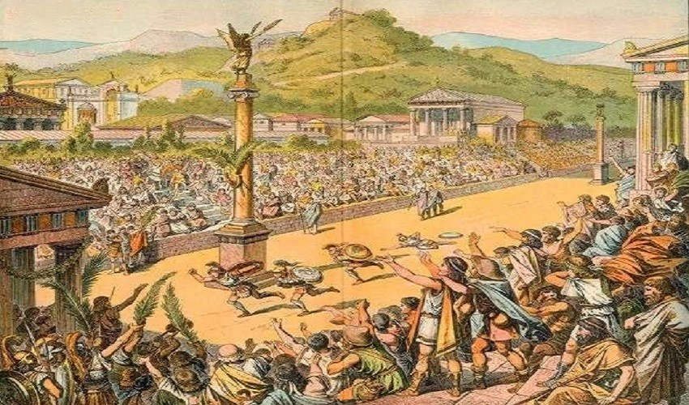
Computing
We will be learning how to code this half term, using Scratch to create animations.
French
We will be practicing speaking and listening in French, by learning greetings and goodbyes and using them in dialogue.
Maths
We will be focusing on multiplicative reasoning, geometric reasoning and number sense.
PSHE/RSE
Our big question for PSHE this half term is ‘Why do we need a class charter and what does it look like?’, in which we will explore boundaries and what makes a positive learning environment.
PE
Hockey and Football
We will focus on Hockey and Football this half term, by following the rules of the games and playing fairly, maintaining possession of a ball with our feet and with a hockey stick, passing to teammates at appropriate times, leading others and how to act as a respectful team member.
Ancient Greece
What were the greatest achievements of Ancient Greece?
English
Instructions
We will be learning about instructions texts this half term, focusing on the text-specific features and writing about how to make our own potions.
Place Value of Punctuation and Grammar
We will be revisiting punctuation and grammar this half term, learning about the position of word types and punctuation to form accurate and effective sentences.
Inquiry
Our inquiry will be focused on Ancient Greece by discussing what we know and what we want to find out, finding out their greatest achievements and creating our own Ancient Greek invention.
RE
We will be learning about Christianity this half term, striving to answer the question, ‘What do Christians learn from the creation story?’
Music
We will be learning to perform and describe Music, by reviewing different types of Music and performing a Greek dance.
Science
We will be investigating materials this half term. We will focus on the three states of matter, to answer the question, ‘Can materials change state?’

