Slide 1
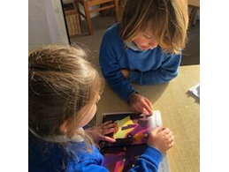
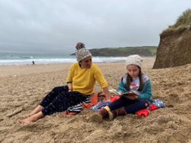
The Teaching and Learning of Early Language and Reading in Germoe and Boskenwyn Schools

Slide 2
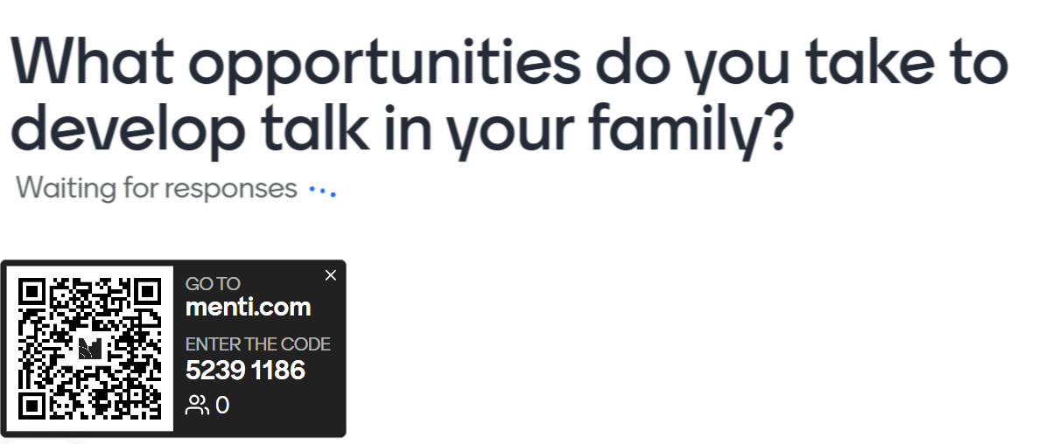
Opportunities to develop talk
Car time- what’s in a word? Nonsense rhymes. Traditional rhymes
Story time
Bath time
Walks- find 5 things that are green
Dinner time- nominate someone to give their top three highlights for the day

Slide 3
Online resources
Words for Life | National Literacy Trust | Words for Life
Speech and Language UK: Changing young lives

Slide 4
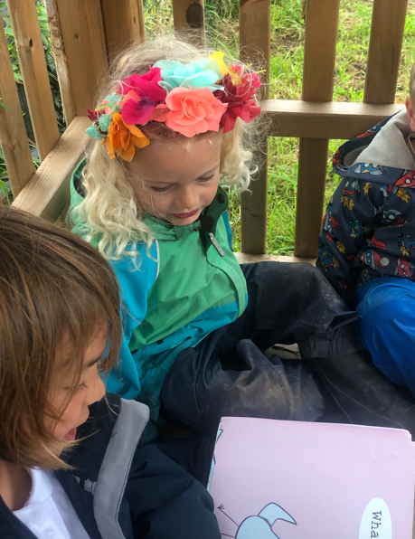
Early language MATTERS
Becoming a fluent, skilled and attentive reader starts at the earliest stages, before children encounter a book for the first time, partly driven by the quality of their parents’10 talk with them that expands their vocabulary and comprehension. This does not appear to happen only in economically advantaged families. This is based on evidence including the example of a study of a group of Spanish-speaking families in the United States, which suggests that: Infants who experienced more child-directed speech became more efficient in processing familiar words in real time and had larger expressive vocabularies…11 To the researchers’ surprise, the differences between the families, who were all disadvantaged, in the amount of talk directed to the child were almost as large as those reported in Hart and Risley’s much-quoted 1995 study, in which the families differed markedly in terms of their socio-economic circumstances: children with wider vocabularies typically came from wealthier families
Reading Framework 2023

Slide 5
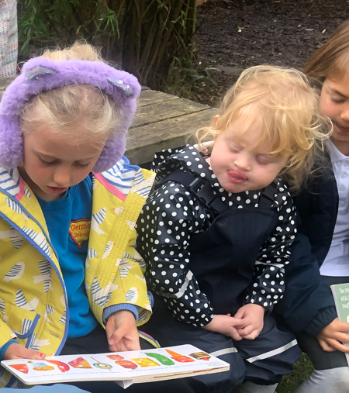
Early Language MATTERS.
Researchers in the United States who had looked at the impact of parents reading with their children quoted the following figures in a news release about their findings:
Here’s how many words kids would have heard by the time they were 5 years old: Never read to, 4,662 words; 1–2 times per week, 63,570 words; 3–5 times per week, 169,520 words; daily, 296,660 words; and five books a day, 1,483,300 words.
The only effective route to closing this gap is for children to be taught systematically to read as soon as they start school. In this way, they do not have to rely on adults to read to them.
Reading Framework 2023

Slide 6
In teaching reading, we have four main (overlapping) focuses
Decoding and fluency
Comprehension
Vocabulary and language building
Love of text

Slide 7
What is RWInc and what is phonics?
https://schools.ruthmiskin.com/training/view/xAsxhnE4/h4gMVSPY
Watch out for the schwa!!

Slide 8
Blending, Fred Talk, special friends, red words… WHAT?!
Fred Talk- talking in pure sounds
Blending- combining these sounds together to read a whole word (aurally and then visually)
Special friends- digraphs, trigraphs and quadgraph
Red words- ‘You can’t Fred a red, you just have to know it!’. The NC calls these CEWs.

Slide 9
When teaching children to read we ask them to spot special friends, Fred talk, blend
Star
Team
Red words are coloured red in the first few book bands, after this children should be familiar enough with them to spot them but might need a reminder. And not everything about a red word is red…

Slide 10
Our commitment
Teach Phonics for 35 minutes daily
Assess half termly
Act swiftly to ensure children ‘keep up, not catch up’
Hear children read at least 3 times a week
Take care to create ‘a buzz about books’
Ensure poems and rhymes are embedded into our daily routines
Plan for vocab building
Plan for talk
Ring-fence story time
Teach ‘Guided Reading’ where we explicitly build comprehension skills

Slide 11
‘Me to you’ and ‘You to me’ books
https://schools.ruthmiskin.com/training/view/AlTGDhO0/LlooegkI
Please listen to your child read every night and please read to your child.
Research by the Institute of Education has also found that the benefits of reading continue as children get older, with the combined effect on children's progress at 16 of regularly reading books and newspapers and visiting the library “four times greater than the advantage children gained from having a parent with a degree”. In short, reading can achieve something teachers and policymakers have been attempting for decades: to lessen or even eliminate the impact of early life disadvantage. (From the DofE Reading Framework 2020)
https://schools.ruthmiskin.com/training/view/mjl3kaYR/f8FoPL5h

